Slide 1
A Practical Introduction to Verilog
Or, who needs M16 anyway
Featuring a collection of god-awful memes made by your loving Workshops co-lead
Slides: https://tinyurl.com/ieeeverilog
Check in: tinyurl.com/1xzz2g8e

Slide 2
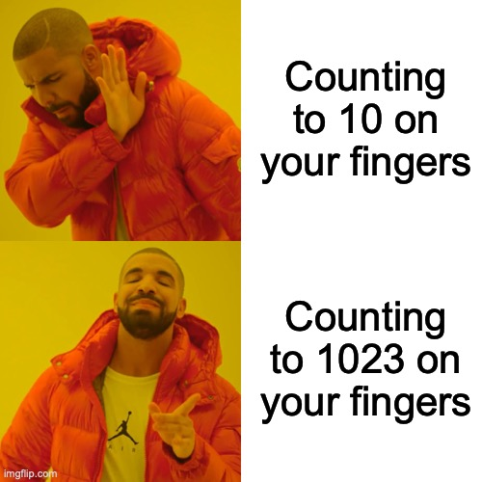
but first, binary
-Humans use base 10 because fingers
-1s place, 10s place, 100s, etc.
-Computers don’t have fingers (yet)
-But if they did, how many would they have?
Notes:
jackie

Slide 3
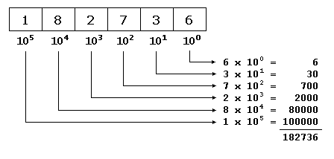
base10 representation
hundred thousands
ten thousands
thousands
hundreds
tens
ones
10
Digit value depends on position in entire number
Each digit is the product of itself multiplied by 10 powered to the digit position as exponent, beginning from the right with 10^0, following with 10^1, 10^2, and so on
Notes:
For base 10, each digit can only take on 10 values, starting from 0 to 9

Slide 4
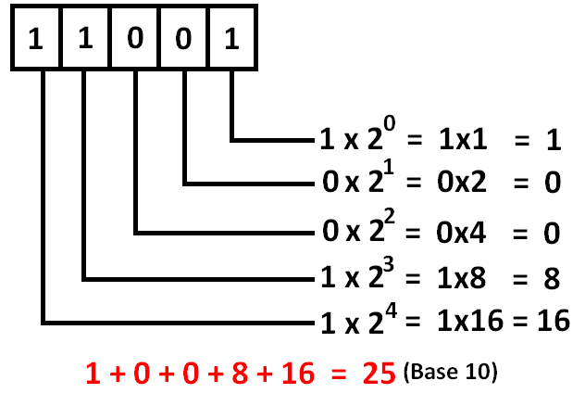
base2 to base10
-Instead of powers of 10, it’s powers of 2!
-1s place, 2s place, 4s place, etc.
-Similar to base10 rep, except base is 2
2
To convert base2(binary) to base10:
Multiple each digit by 2 (base) raised to the power of the digit place starting from 0 on the right
Sum each individual term to get base 10 representation
Notes:
jackie

Slide 5
binary ins and outs
-What about negative numbers?
-Two’s complement encoding!
-First bit (the leftmost) indicates the sign, where 1 = negative, 0 = positive.
-In computers, 1 digit is called a bit, 8 is a byte!
Examples: Plain ol’ binary:
1101 – 13
(1)2^0 + (0)2^1 + (1)2^2 + (1)2^3 = 13
101101 – 45
1111111111 (ten 1’s) – ?
Hint: 10000000000 - 1 is equivalent
Examples: Two’s complement
1101 – -3
01101 – 13
1111111111 – ?
Notes:
Could do 2^0 to 2^9, but it is the same as 2^10 - 1.
-1. Think of it as a large negative number subtracted by the most positive number

Slide 6
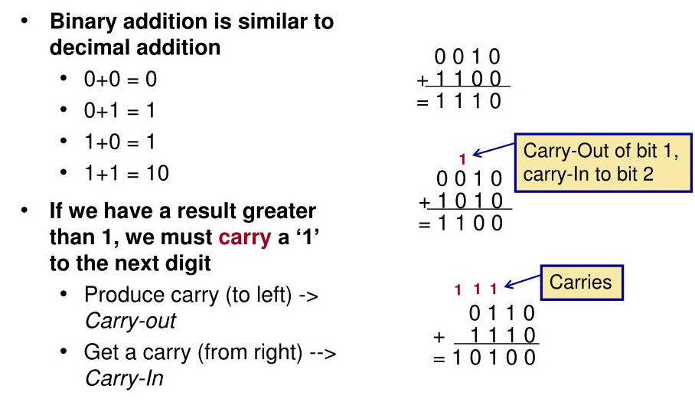
binary operations
Examples: Addition
1010 + 0100 = 1110
1011 + 0001 = 1100
1111 + 0001 = ?
-For addition, carry operations work as usual
-But note, 1 + 1 = 0 (with carry)
-Similar for subtraction
-Note that 0 – 1 = 1 (with borrow)
Examples: Subtraction
1101 – 0101 = 1000
1011 – 0100 = 0111
1000 – 0001 = ?
Notes:
10000
111

Slide 7

binary meme break time ft. the zuck
Notes:
Questions?

Slide 8
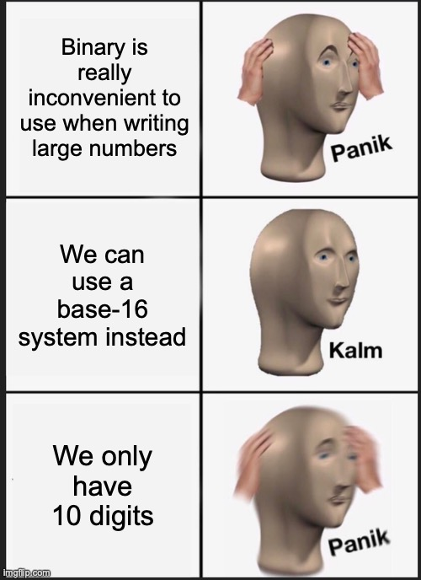
hexadecimal: binary’s big brother
-Question in all your minds: What if computers had 16 fingers?
-Well, we’d probably need a base-16 system then
-But we don’t have sixteen digits, you say
-So what else can we use?

Slide 9
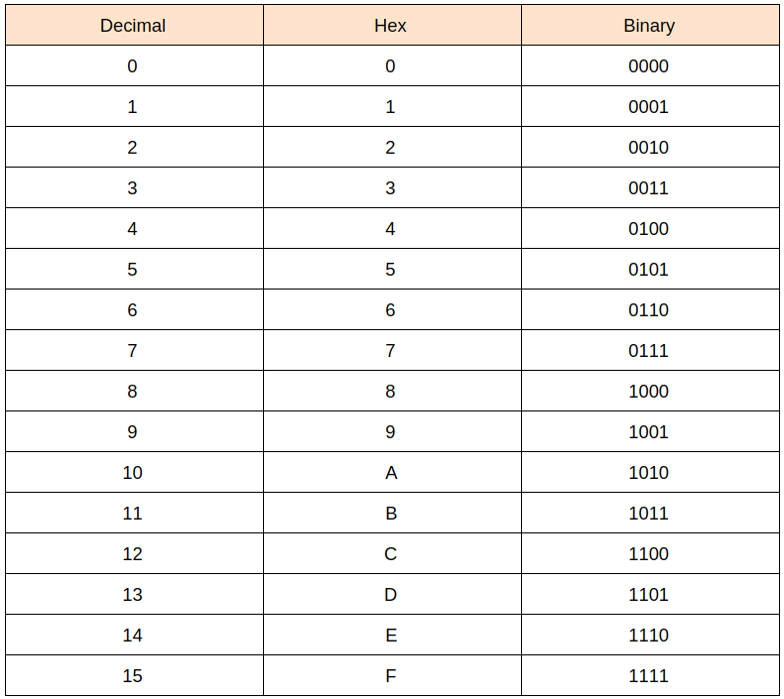
hex: a tale of four bits
Examples: Hexadecimal
0xB = 11, 0xF = 15 (half byte)
0x1C = 28 = 0b00011100 (1 byte)
0xA4 = 164 = 0b10100100 (1 byte)
0x00A4A6FF = 10790655 (4 bytes)
-We use letters to represent 10-15!
-Often used in addresses (hello CS33)
-Denote with 0x e.g. 0x1A3B
-Each hex digit represents four binary bits!
-So two hex digits is a byte

Slide 10
bitwise operations
-Operations done on bits! (Shocking, I know)
-Simple ops on a bit, or between two bits
-Similar to Boolean AND, OR etc. (But not quite)
-Combinations of them form non-bitwise ops
-We’ll use these in Verilog
Bitwise Operators:
AND: &
OR: |
NOT: ! (or ~)
XOR: ^
Shift: <<, >>
Boolean Operators:
And: &&
Or: ||
Not: !

Slide 11
bitwise examples
Multiple bits:
1101 & 0101 = 0101
1001 | 0101 = 1101
~1010 = 0101
1101 ^ 1011 = 0100
0010 << 2 = 1000
-Unlike Boolean, bitwise can be done on multiple bits
-Single bit AND: 1&1 = 1 1&0 = 0
0&0 = 0 0&1 = 0
-Single bit OR: 1|1 = 1 1|0 = 1
0|0 = 0 0|1 = 1
-Single bit XOR: 1^1 = 0 0^1 = 1
0^0=0 1^0=1
-Single bit NOT: ~0 = 1 ~1 = 0
Question 1:
Assuming two’s complement, how would we negate a number?
Question 2:
What’s a super-simple way to bitwise multiply by 4?

Slide 12
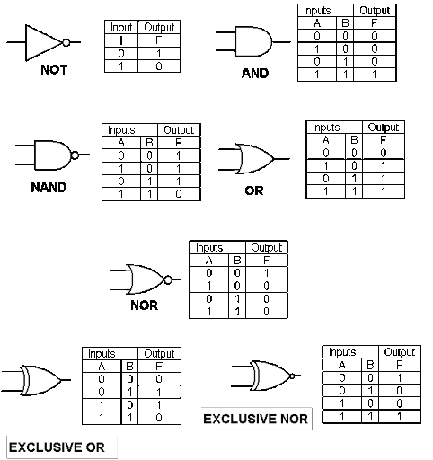
logic gates: binary in circuits
-logic gates are physical components
-they are made from transistors
-sometimes, chips with single gates are used
-usually, a whole bunch are stuffed on a chip
-FPGAs y’all!

Slide 13
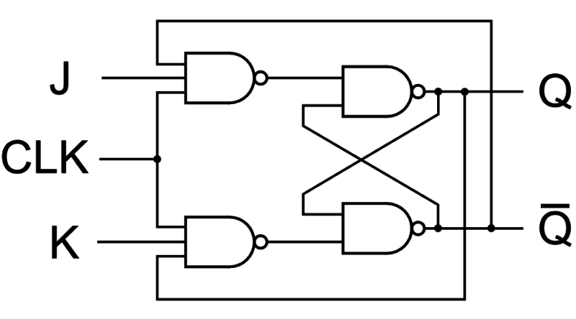
flip-flop: an altered state
-We’re almost to Verilog, but first we need one more thing
-Flip-flops are a type of component in either state 1 or state 0
-Its output (and often negated output) is always available

Slide 14
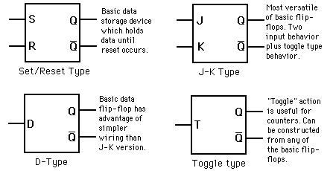
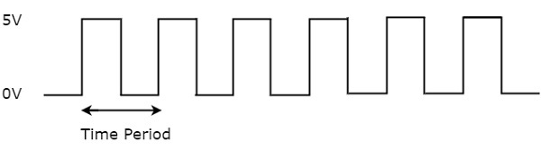
flip-flops
-Several kinds of flip-flops
-Not gonna get too far into deets
-But note, these are usually clocked
-Clocks are square wave inputs that have a known frequency
-They are used for timing purposes in circuits (sequential logic)

Slide 15
logic design fundamentals
-Why exactly did we learn all this?
-Computers operate using bits, and we design basic computer functions from gates
-Transistors -> gates -> modules -> logic
-Basically, this stuff is a window into how computers do what they’re supposed to
-Understanding logic design will take a whole class, but here’s a brief overview

Slide 16
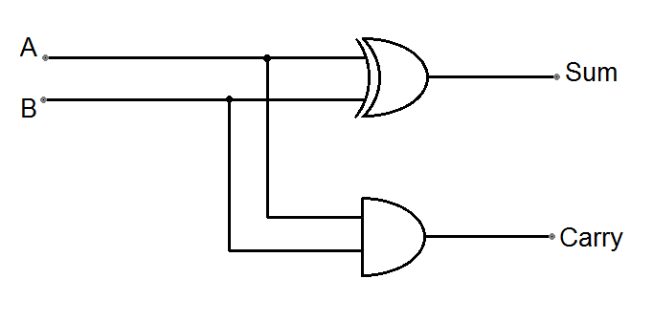
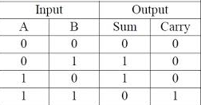
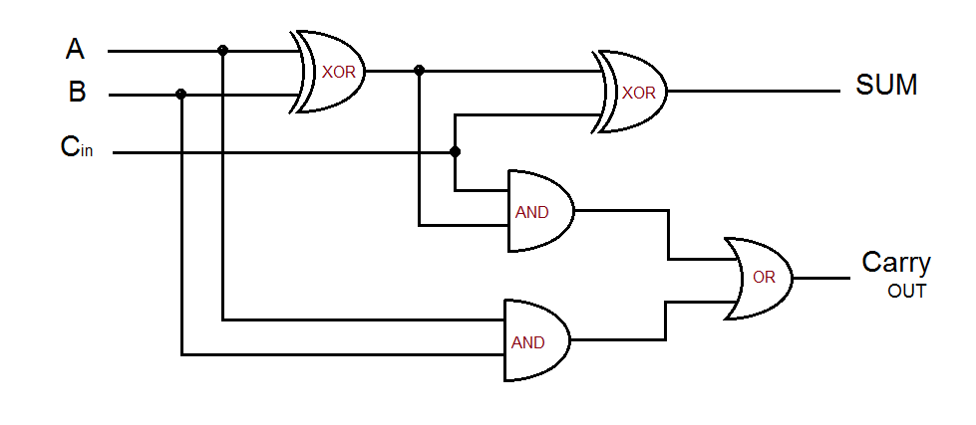
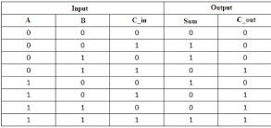
logic design examples: adders
Half Adder:
Full Adder:

Slide 17
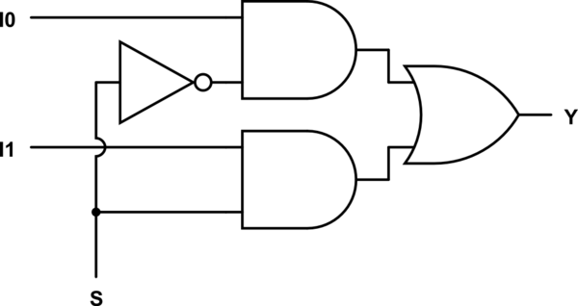
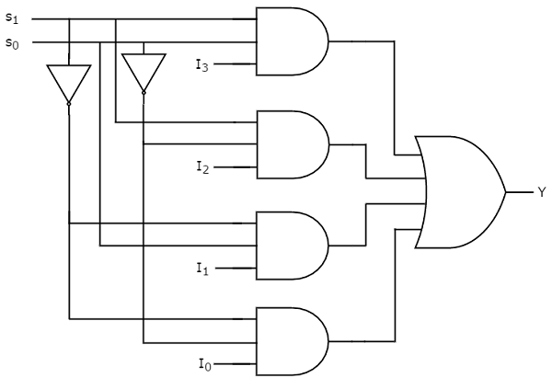
logic design examples: multiplexer
The Idea:
What if we had multiple possible inputs but wanted to be able to select a particular one? We’d need a select line to use in our logic, but with how many bits?
The execution:

Slide 18
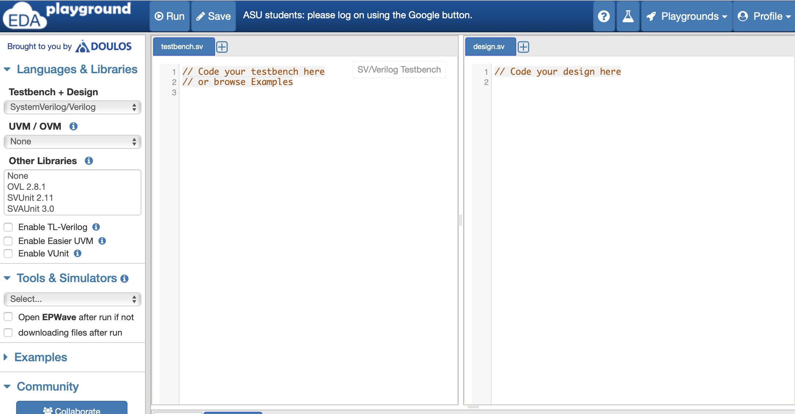
time… for Verilog
-Today we’ll be using an online IDE/simulator
-EDAplayground: edaplayground.com
-Here, we can write our SystemVerilog code
-And we can also see waveforms!
-Go and make an account real quick
Notes:
switch

Slide 19

what exactly is it?
-Verilog is a Hardware Description Language
-Use code to build logic designs
-Can just be simulated, or can be uploaded to FPGAs
-Is a bit trickier than C, C++, or Python
-Google will let you down!

Slide 20
getting started
-There are two main parts you need to code: modules and a testbench
-Modules are your individual logic designs (adders, MUXs, etc.)
-Testbenches are where you create input waveforms and make outputs
-These are done in different files. (left and right in EDAplayground)

Slide 21
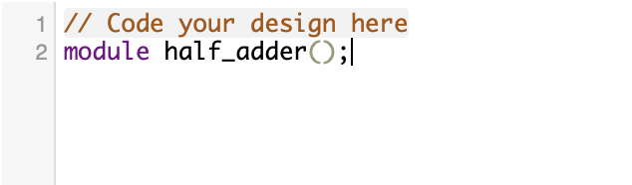
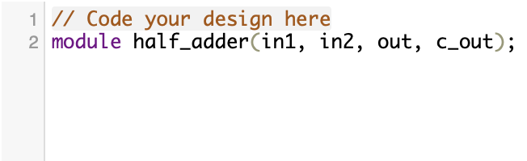
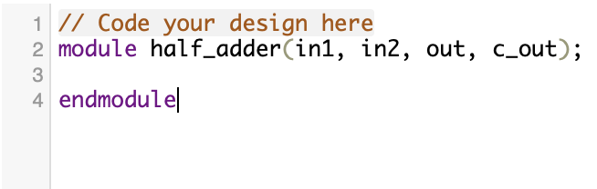
modules
-Modules are kinda like python functions
-Declare with keyword module
-Note the odd semicolon(;) placement!
-Parameters don’t need types
-Each parameter is an input or output
-End the module with keyword endmodule

Slide 22
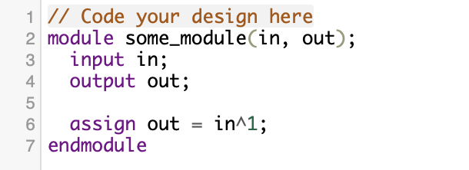
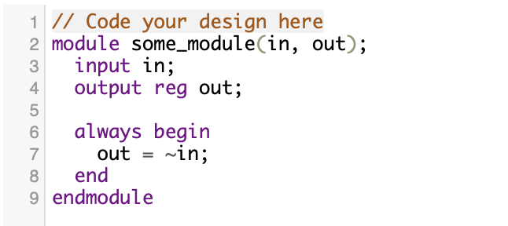
nets
-Nets are like variables and physical wires
-Nets just pass values from one end to another
-In modules, they’re either inputs or outputs
-They can be modified with the reg keyword
-Regs are modified in “always blocks” (later)
-Normal wires are given values with “assign”

Slide 23
example one: half-adder
-There are no clocked elements in a half adder
-So, just assign statements will do the trick
-This is called combinational logic
-Note inputs, outputs and logic gates
-Now we can begin!

Slide 24
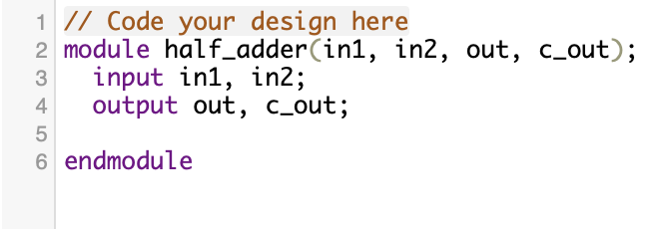
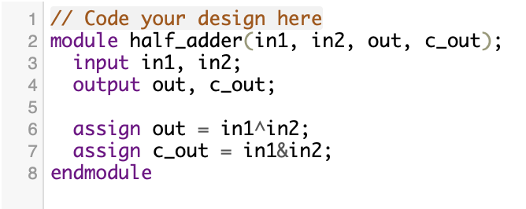
half-adder cont.
1. Create module with appropriate parameters
2. Designate correct inputs and outputs
3. Assign using correct logic gates

Slide 25
example two: 4 to 1 multiplexer
-Once again, no clocked elements
-So, just assign statements will be fine
-But, we would prefer to have a single select input
-Can we create a multi-bit input?
-Of course! Let’s see how
Notes:
travis

Slide 26
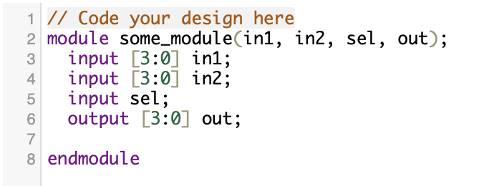
multi-bit wires
-We use brackets to define the size of our wire
-The order of numbers in the brackets is important!
-For wire [3:0] in = 1010, in[0] == 0
-For wire [0:3] in = 1010, in[0] == 1
-This is great as a select input (how many could the above wire select from)
-We can also use multi-bit inputs for larger adders, etc.

Slide 27
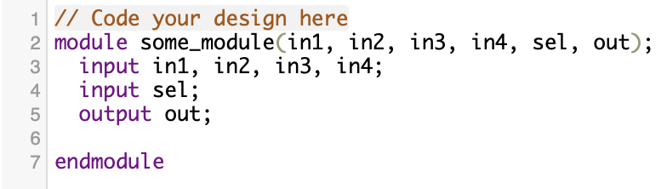
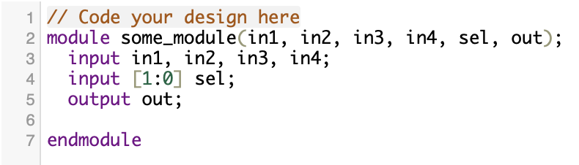
more multiplexer
-So, our select input will be multi-bit (how big?)
-Create appropriate inputs and outs
-Then use logic gates for the body?
-We could, or we could use some abstraction
-This is one of Verilog’s great benefits!
-We can use some coding syntax rather than purely describing a circuit

Slide 28
abstraction with conditional op
-Conditional operator syntax ? : is available in Verilog (you might have seen it in C++)
-Example: condition ? exp_if_true : exp_if_false
-Since true and false are simply 1 and 0, we can use bits from the select input as conditions
-By nesting a couple of these conditionals, we can get the logic we want!
-By doing this, we circumvent the need to use logical operators directly
-We don’t always want to do this, but it’s good to know we have the option

Slide 29
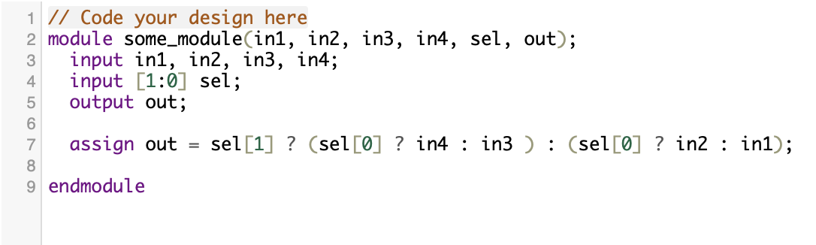
the finished multiplexer

Slide 30
a questiøn
What does Verilog code represent in the physical world?

Slide 31

testbenches
-The less fun part of Verilog
-What if have a big, hairy module?
-You need to make sure it works right!
-Unless you wanna get fired…
-That’s where testbenches come in!
-You need to create a bunch of combinations of inputs and outputs to supply to modules
-Then you can analyze the square wave pattern (1 or 0) produced
-This way you’ll make sure that your module is not faulty

Slide 32
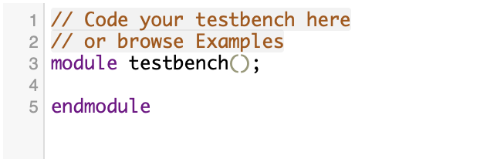
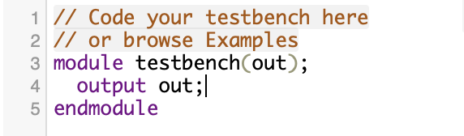
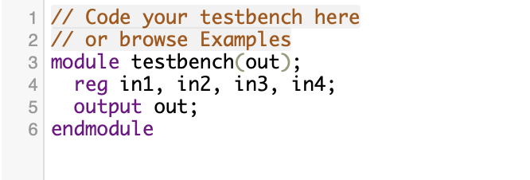
leaving The Shire
-Dirty secret: a testbench is a module too!
-Create with module keyword
-End with endmodule keyword
-This module won’t have inputs
-But it should have (an) output(s)!
-We’ll also need inputs to our modules
-Use regs for these (explained later)

Slide 33
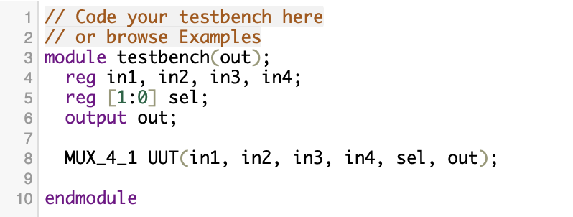
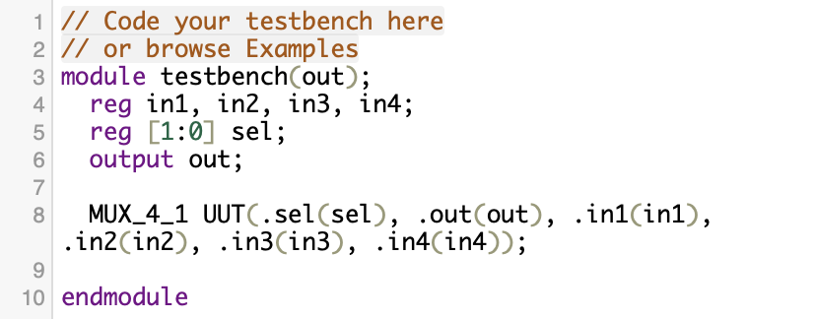
instantiation
-We want to test our other module
-So we need an instance of it (like in C++)
-Name it whatever you like
-Instantiation can be in order
-Or out of order with slight modifications

Slide 34
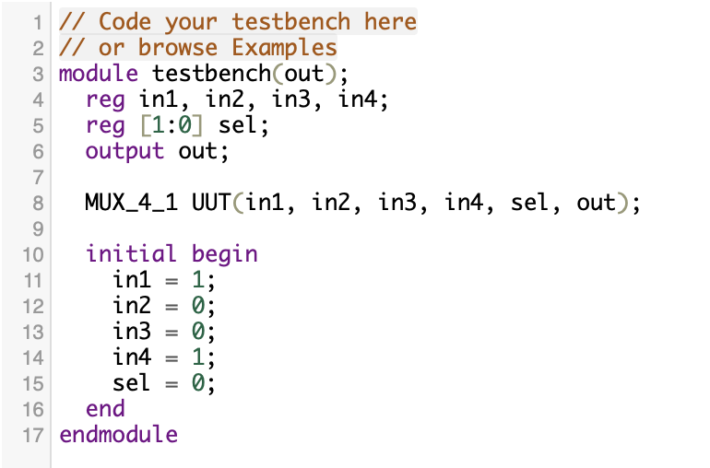
instantiation (of variables)
-This is done within an “initial begin” statement
-It runs once, beginning at the start of runtime
-If we don’t do this, we’ll get waveform issues
-I chose random input bits
-We start sel at 0 (00)
-There will be more in this section later!

Slide 35
strategy behind inputs
-We now want to manipulate these inputs to get a range of combinations
-These combinations should test all possible inputs of the module
-So somehow, we’ll have to change them during the runtime
-And somehow, these changes will have to occur at carefully timed intervals
-How in the world can we do this?!?

Slide 36
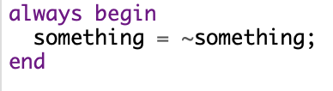

always blocks
-Always blocks are ALWAYS active (shocker)
-They begin at the beginning…
-…and finish with your program
-Within them, you can change registers
-There are a couple different kinds
-Always begin (good for testbenches)
-Always @ (good for modules)

Slide 37
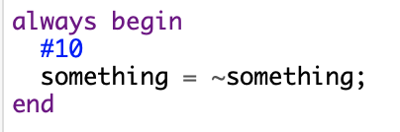
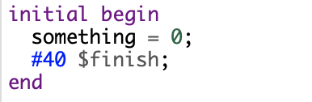
Timing your blocks
-But wait, how would that first block work?
-It’s constantly wavering between values
-We must use delays (# operator)
-Delays by x ticks (ns, or other as defined)
-Doesn’t need semicolon
-Now, we can define a runtime in initial begin
-To end, we use keyword $finish
-How many times will something invert?

Slide 38
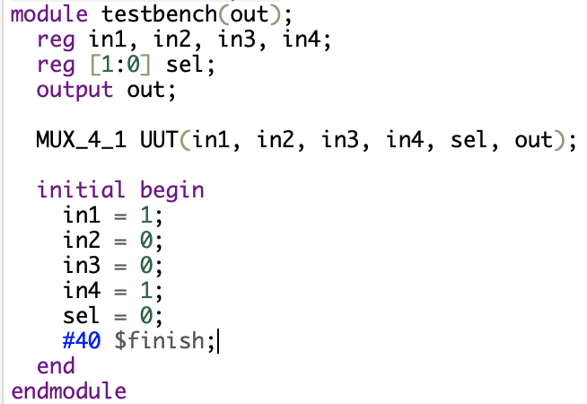
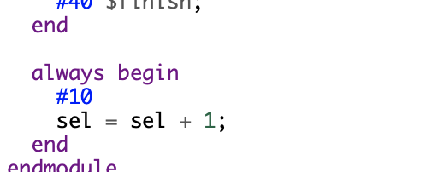
putting it together
-First, how many values do we want to check?
-We must change sel this many times
-Let’s say our overall program is 40 ticks
-How many ticks for our always block?
Alright! We’ve made our module and testbench.

Slide 39
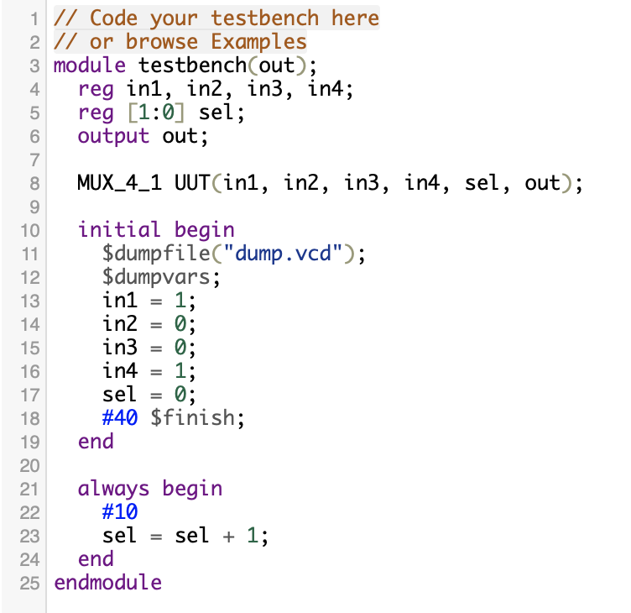
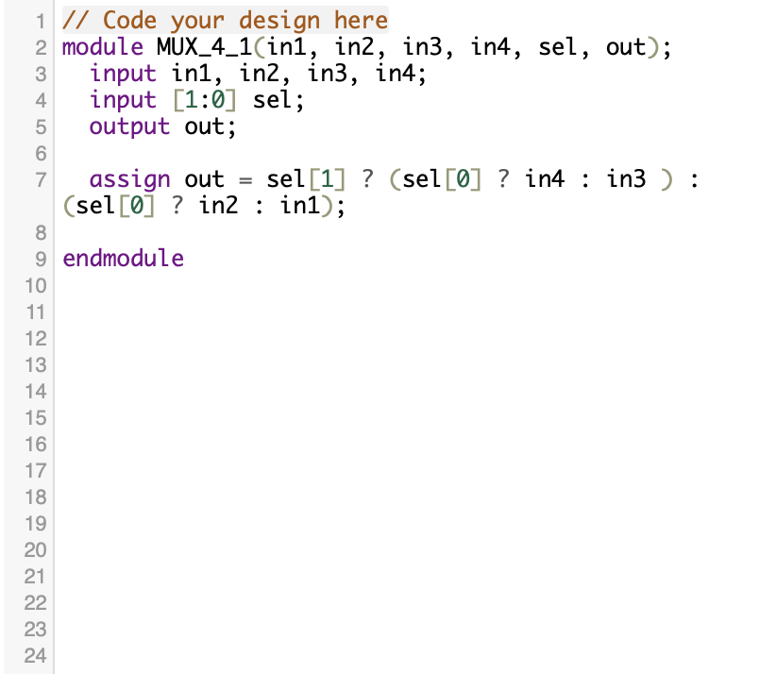
multiplexer + testbench

Slide 40
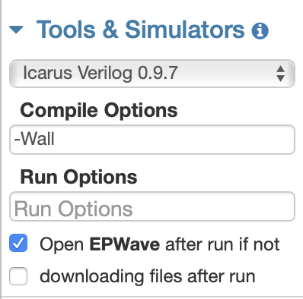
waveforms: modules in motion
-In case you didn’t see, we need $dumpfile
-Just an EDAplayground thing, not general
-Now we need to simulate our design
-First choose tools: Icarus Verilog 0.9.7
-Select the open EPWave option
-Then we’ll hit run!

Slide 41
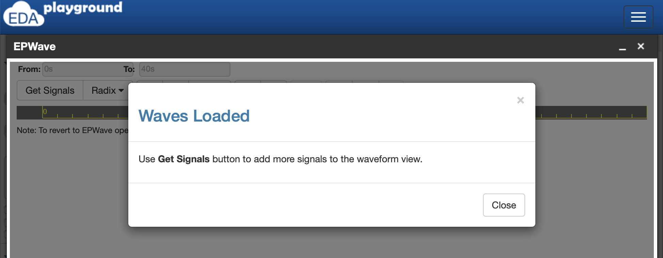
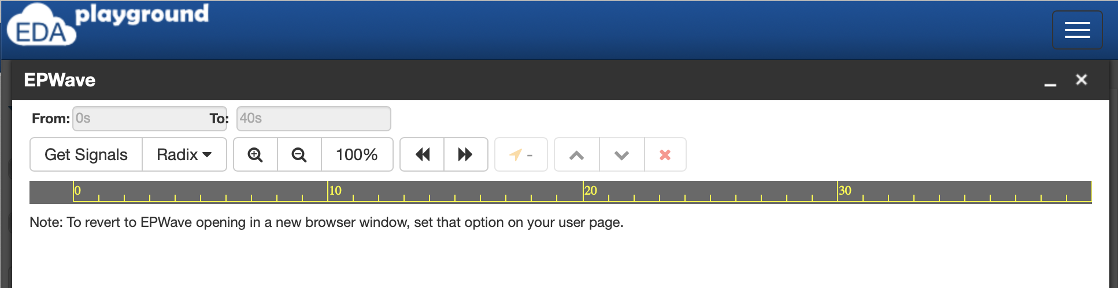
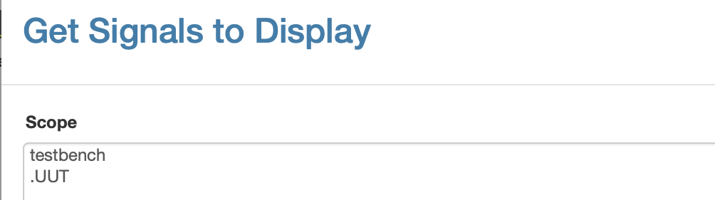
waveforms
-If run is successful, this pops up
-Next we need to click get signals
-Select the testbench
-You will see options of signals to select
-Instead, just click append all

Slide 42
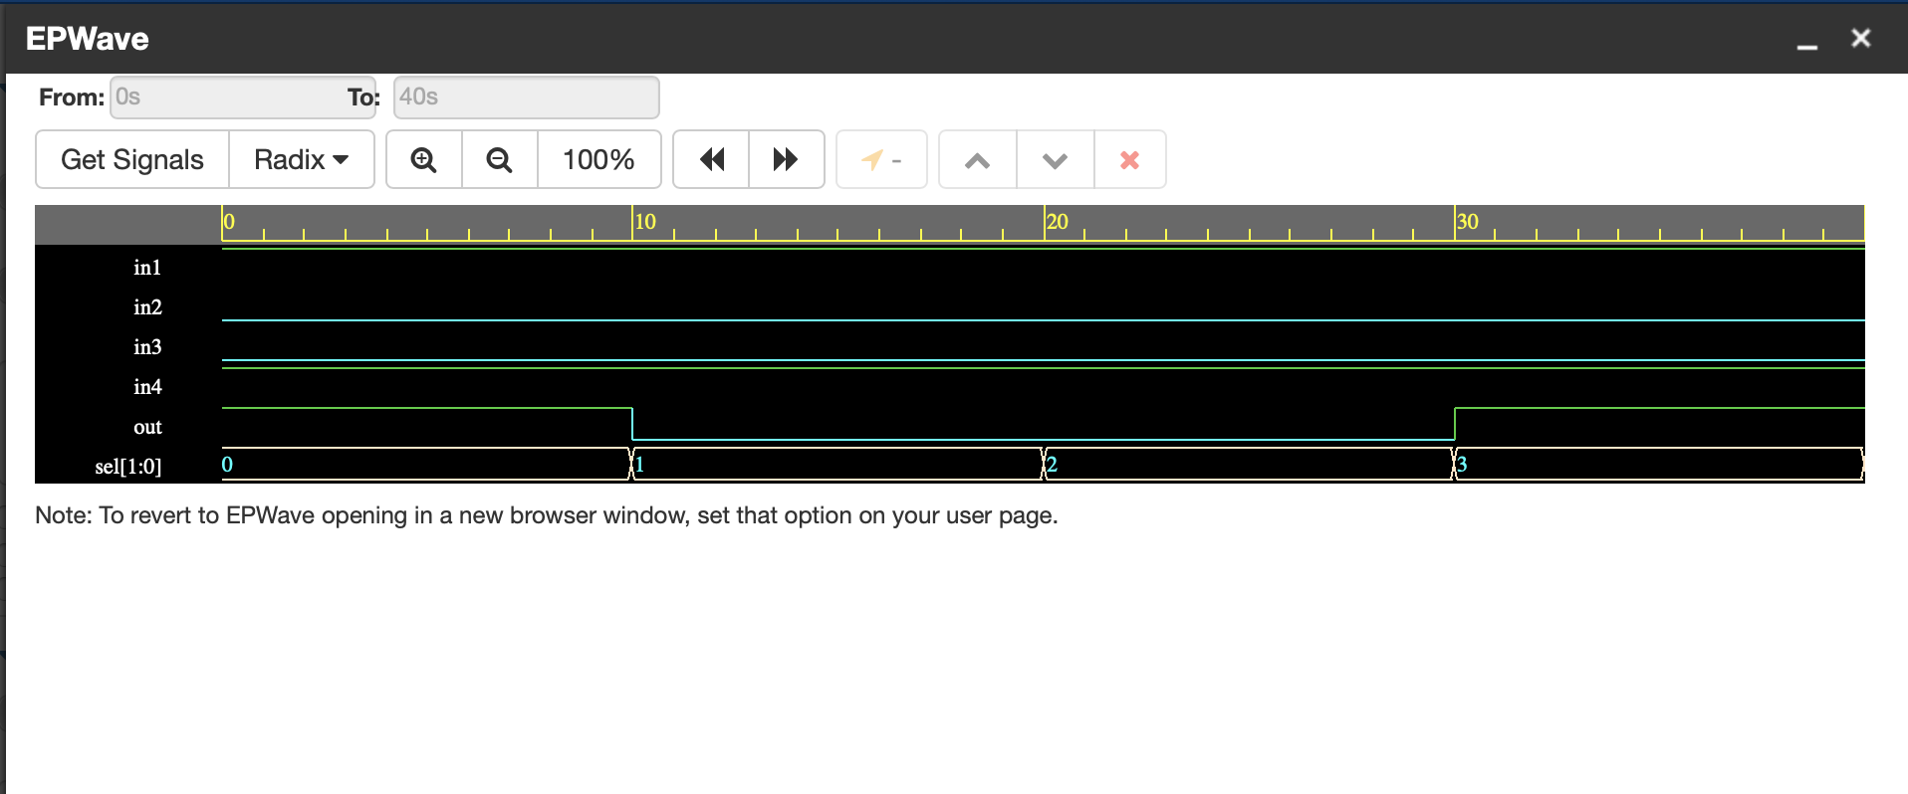
checking the waveform
-Here we see our ins and out as either high or low (1 or 0)
-We can confirm that they are correct

Slide 43
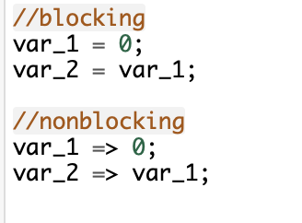
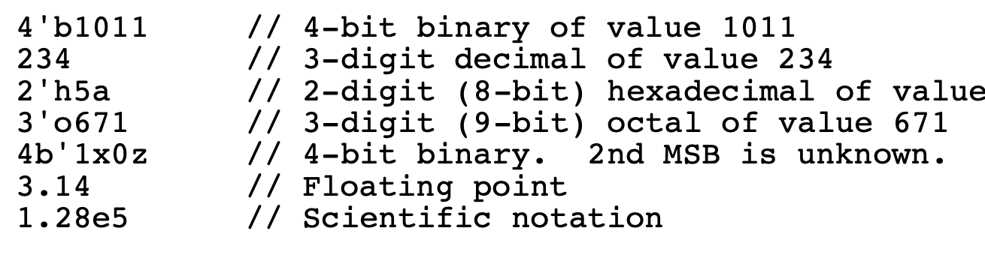
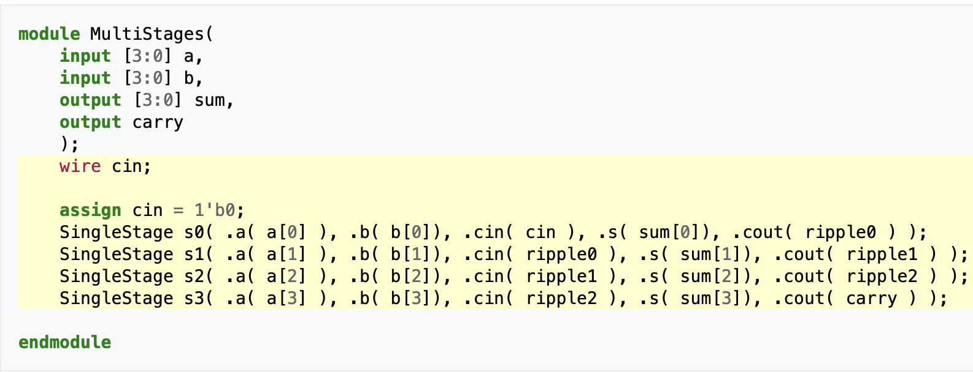
assorted further Verilog stuff
-Timing: blocking and nonblocking
-Be aware of constants’ bases
-Modules called within modules
-Many more topics to explore
http://ee.sut.ac.ir/People/Courses/142/Summary%20of%20Verilog%20Syntax.pdf?fbclid=IwAR0kVAYIYWTxKJh-OPf5gbNR13zvp5KXJ4L4Z20RmeakZLbv6-YAehcfPrk

Slide 44
time to Kahooooot
Notes:
jackie
https://create.kahoot.it/share/verilog-and-digital-logic/b408c6ef-2da1-4f61-87b1-1d78db1b4ad0

Slide 45
collaborative project
-We’re going to make a full adder and testbench
-First what’s different between half and full?
-Quick refresher on the logic design
-Follow along on your own computers
-Alright, let’s get started!
Notes:
travis

